Slide 1
Web Programming II
For next time
Add diagram to show how AJAX conceptually works
More on how AJAX works (get content from remote, add to DOM)
Example would be:
Always show up to date temperature
Google Maps too
Programming Usable Interfaces (PUI)
05-430/05-630 Fall 2018
Jason Hong
jasonh@cs.cmu.edu

Slide 2
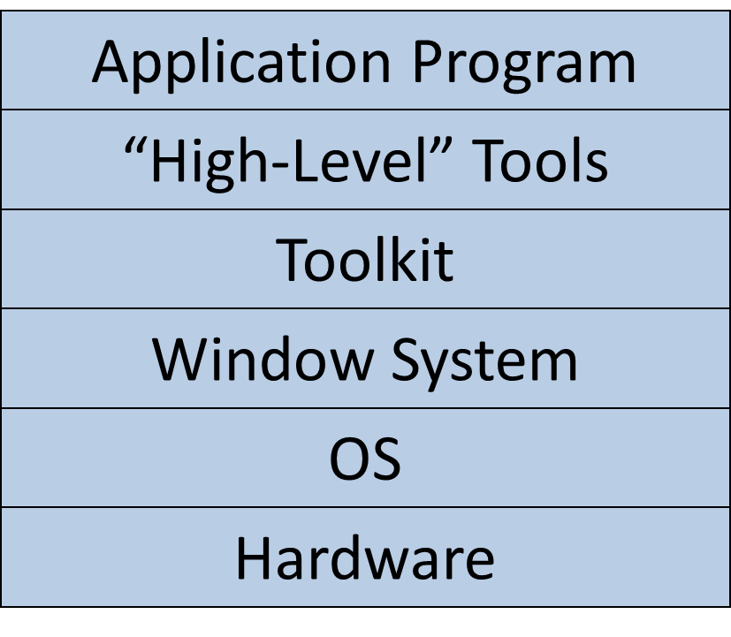
Previously…
Core concepts of modern GUIs
Widgets
Component Trees (DOM)
Model-View-Controller (at all scales)
Event-driven programming

Slide 3
How Developers Work
Try a little
Look up documentation
http://api.jquery.com/
Or do a search, e.g. “jquery add element”
Make a guess as to right approach
Look up error message
“Uncaught SyntaxError: Invalid or unexpected token”
Test that code does what you think it does
Repeat

Slide 4
Principles and Patterns Separation of Concerns
Don't intermingle things that shouldn't be intermingled
CSS is a great positive example
Separates styling from HTML content
HTML used to be content + style
Was nightmare to change look and feel across entire web site, had to edit multiple files, multiple spots
Model-View-Controller is another good example
Separates data model from presentation and UI

Slide 5
Principles and Patterns Loose Coupling
Components should depend on other components minimally
Should not know the internals of how other components work
Should only interact through well-defined APIs
MVC is a good example
VC only interact with M loosely
Easy to replace
Easy to modify one without modifying everything

Slide 6
Principles and Patterns High Cohesion
Organization of objects and functions should be simple and make sense
Each object and function should have simple goal
Goal should be predictable based on names
Ideally, names are consistent too
Example:
logMessage() vs logMessageAndDelete()
onclick() / onmouseenter()
JQuery less good here, click() / mouseenter()

Slide 7
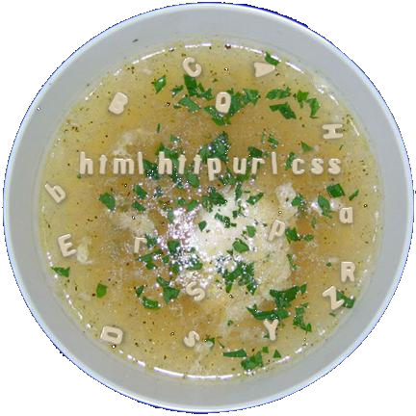
Today, Rest of Alphabet Soup
Give you a rough mental model of how rest of things fit together
When working in teams, they may be using these
Understand things that developers say too

Slide 8

Quotes from Karen Berntsen
I’m working with hibernate to bundle a servlet request.
There’s a data abstraction on top of the preferences so it looks like a file server.
Lets formalize the crawl criteria!
My chrome is tight.
Taking the XSLT idea one step further, you could have something that skins that index block as an XML file that you then consume on the client side using ajax.
Do we have a washing machine?
Notes:
My chrome is tight.
Hit left bracket to toggle.
I got our Synology NAS to accept SFTP.
The CMS max heap size increase was picked up by the weekly restart.
Every time we mount tomcat we run into name-space collisions.
The table rendering is truncated.
An unsynchronized hash map can result in an infinite loop that pegs the CPU when doing a “get”.
I’m working with hibernate to bundle a servlet request.
Just load astudent object that’s rendering a lazy load when plugging into legacy code.
Send a sig quit, not a sig huff and look for threads that were stuck in the same method.
Lets roll a VM box.
Having a cold standby would be okay.
I’m less attached to full redundancy.
Let’s separate the TSD’s from the VM scheduling.
What’s the status of soap lite?
Audit is not concerned with how VM’s co-habitate.
It’s done for pub tomcat, pending for vap tomcat.
Taking the XSLT idea one step further, you could have something that skins that index block as an XML file that you then consume on the client side using ajax.
Lets formalize the crawl criteria!
Does it R-sink to the hot backup?
Friendly url’s can be pages, not portlets.
Can we build a wrapper around the current alias generator?
Just perform a Solaris root password recovery.
Is there cruft in the metastore?
There’s a data abstraction on top of the preferences so it looks like a file server.
There are richer semantics than RSS.
Please do a didactic translation.
Do we have a washing machine?
Darcy is pro-Linux and anti-Solaris.
We are wrestling with full server realization.

Slide 9
Example Alphabet Soup Today
HTML, CSS, JavaScript, JQuery
XHTML, XML, JSON, SOAP, ASP, JSP, PHP
RSS, CDNs, Database
REST, AJAX, W3C, iframes
This is not a strict history of web
Better mental model of modern web
Help you understand how web evolved and how these various pieces fit together

Slide 10
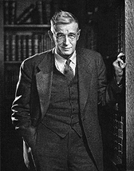
Origins of Hypertext
Vannevar Bush
Coordinated WWII scientific effort
Developed “social contract for science”
Federal government funds universities
Universities do basic research
Research helps bolster economy and national defense
Became basis for the National Science Foundation
Influenced development of DARPA as well
Notes:
Picture of Bush from http://www-eecs.mit.edu/AY95-96/events/bush/

Slide 11
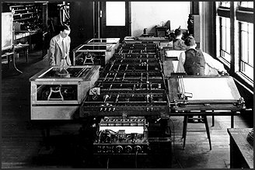
Origins of Hypertext
Famous 1945 article “As We May Think”
http://www.theatlantic.com/doc/194507/bush
Identified fundamental problem: too much information
Notes:
Picture of Bush from http://www-eecs.mit.edu/AY95-96/events/bush/

Slide 12
Quotes from As We May Think
“[W]e are being bogged down today as specialization extends. The investigator is staggered by the findings and conclusions of thousands of other workers—conclusions which he cannot find time to grasp, much less to remember, as they appear.”

Slide 13
Quotes from As We May Think
“[P]ublication has been extended far beyond our present ability to make real use of the record. The summation of human experience is being expanded at a prodigious rate, and the means we use for threading through the consequent maze to the momentarily important item is the same as was used in the days of square-rigged ships.”

Slide 14

Origins of Hypertext
Lots of ideas for inventions in the article
Wearable cameras for photographic records
Encyclopedia Brittanica for a nickel
Automatic transcripts of speech
Direct capture of nerve impulses
Memex
First idea of hypertext
Large display
Can link articles together
Notes:
Picture of Bush from http://www-eecs.mit.edu/AY95-96/events/bush/

Slide 15
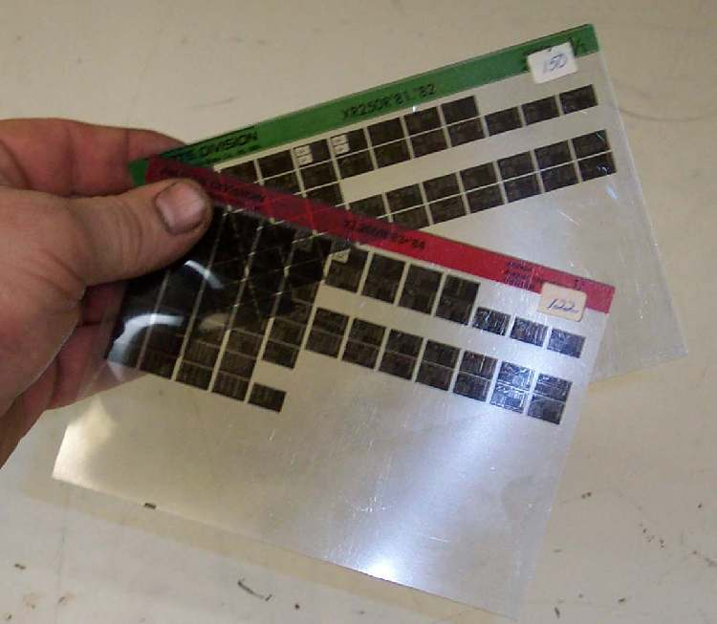
Notes:
This is microfiche technology, which is what Bush was thinking would be used. These are all essentially small screenshots.

Slide 16
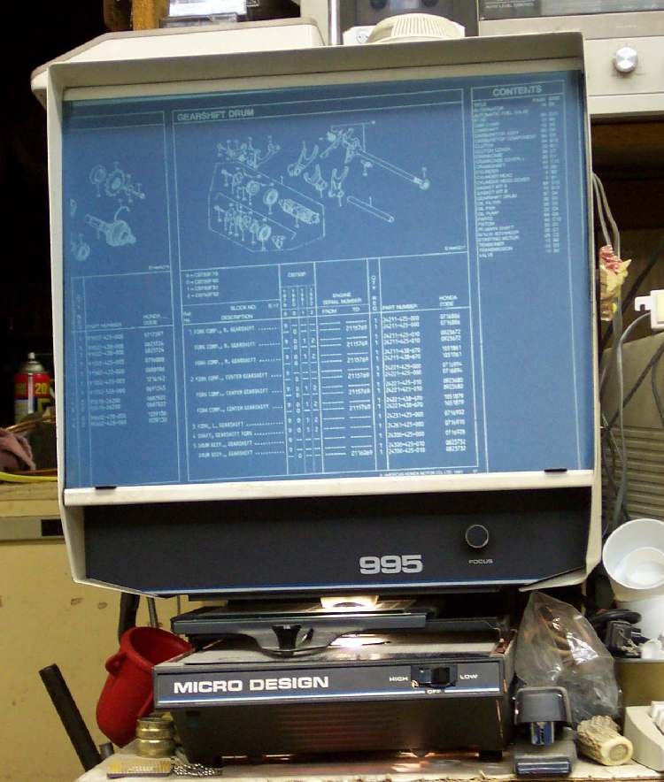

Slide 17

Origins of Hypertext
Ted Nelson
Coined “hypertext” and “docuverse”
Xanadu, started in 1960s, end-all be-all of hypertext
"longest-running vaporware story in the history of the computer industry" – Wired
Engelbart credited with first implementation
Key Ideas:
Micropayments
Transclusion, combining multiple documents
StretchText

Slide 18
Stretchtext Example
In Stretchtext, text is stored as a stream. Extra text is coded to pop in and out at desired altitudes.
In Stretchtext, a kind of hypertext, text is stored as a stream. Extra text, invisible at one level, is coded to pop in and out at desired altitudes, under user control.

Slide 19
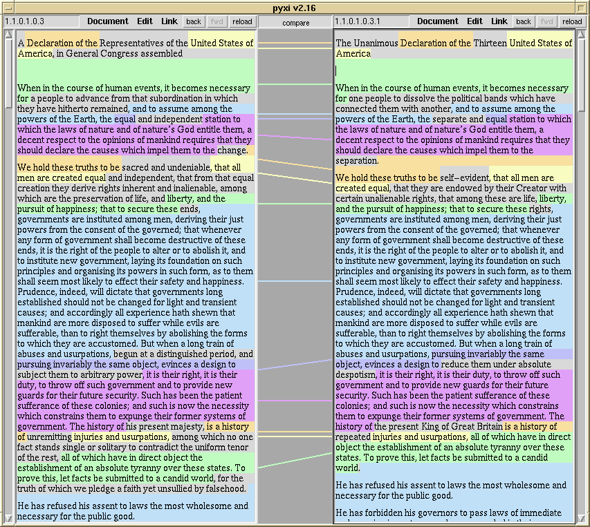
Udanax (Xanadu backwards)
Udanax Green
Rough draft created as new version (left); edited to produce new (right)
Keeps tracks of edits so both portions remain same
“Transpointing window"

Slide 20
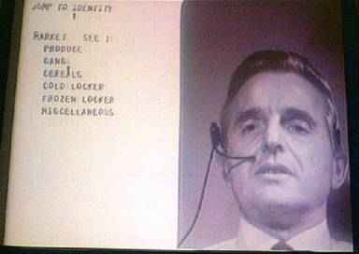
Engelbart and Hypertext
Some Famous Firsts
Edit text interactively
Click on “links”
Mouse
Two-handed interaction
Windows (non-overlap)
More later this semester

Slide 21
State of Hypertext around Late 1980s
Lots of research into hypertext but no widely-deployed systems
Lots of small systems
Lots of research on understandability of hypertext
Lots of research on better authoring tools
Most hypertext systems weren’t aimed at network
Packaged for single computers
Most assumed centralized control
No dead links!

Slide 22
The Initial World Wide Web
Hypertext + networking -> World Wide Web
HTML, URL, HTTP
Browser - Server
URL
Web
Browser
Internet
Web Server
Server
HTML

Slide 23
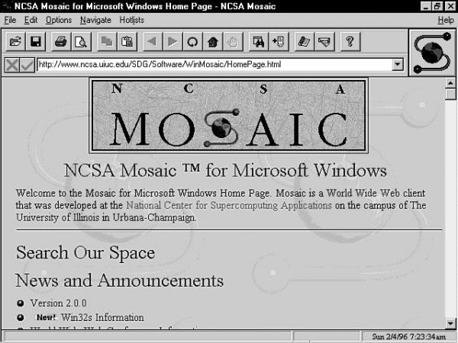
But no support for graphics…
Notes:
Mosiac web browser, Marc Andreesen added img tag
(Now Andreesen Horowitz)

Slide 24
But no support for graphics…
Marc Andreesen helped create Mosaic browser
Now of Andreesen Horowitz VC fame
Added <img> tag
Also standardized blue links
Notes:
Mosiac web browser, Marc Andreesen added img tag
(Now Andreesen Horowitz)

Slide 25
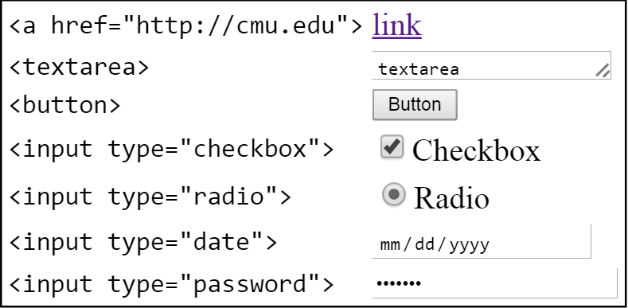
But no interaction beyond links
HTML forms invented
Added buttons, checkboxes, radio buttons, etc

Slide 26
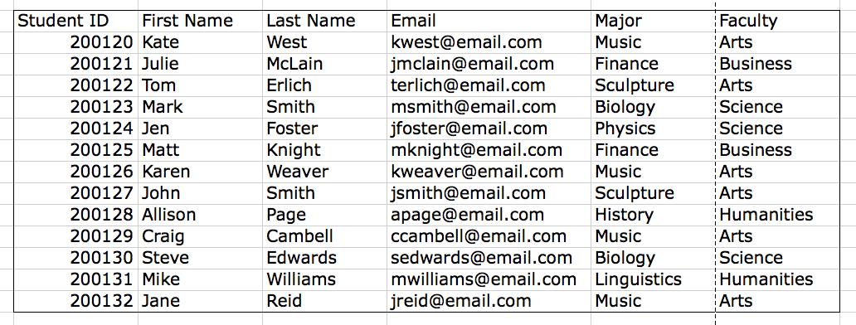
But pages were mostly static…
People wanted to generate content on the fly
Show different content to different people
Load content from databases
Think of a database like a gigantic Excel table
Notes:
http://wiki.ucalgary.ca/page/Courses/Computer_Science/CPSC_203/CPSC_203_Template/Labs_Template/TA_Examples_for_Access

Slide 27
But pages were mostly static…
People wanted to generate content on the fly
Show different content to different people
Load content from databases
Think of a database like a gigantic Excel table
Columns describe some data field
Makes it fast, easy, and reliable to store lots of data
Makes it fast and easy to query data
This is where SQL comes in, for querying databases
SELECT * FROM PUI WHERE Name = “ Jason”;

Slide 28
But pages were mostly static…
URL
Web
Browser
Internet
Web Server
Server
HTML
Database

Slide 29
But difficult to create web pages on the fly
Might generate HTML on the server on demand
System.out.println(“<html>”);
System.out.println(“<body>”);
System.out.print(“<div id=\”“ + str + ”\”>”);
Messy, mixes application logic with presentation
Also hard to read
Ideas on how to address this problem?

Slide 30
But difficult to create web pages on the fly
Template languages
Instead of code that generates HTML, have HTML that contains code that is run when page requested
Active Server Pages (ASP and ASP.NET), PHP, JavaServer Pages (JSP)
Still a little messy, but much better than previous
<p>Counting to three:</p>
<% for (int i=1; i<4; i++) { %>
<p>This number is <%= i %>.</p>
<% } %>
<p>OK.</p>
Notes:
https://en.wikipedia.org/wiki/JavaServer_Pages

Slide 31
Evolved into LAMP Architecture
Another good example of layers
Different responsibilities at each layer
Templating
PHP
Database
MySQL
Web Server
Apache
Operating System
Linux

Slide 32
Evolved into LAMP Architecture
Another good example of layers
Different responsibilities at each layer
Can replace an individual layer
Templating
PHP, Ruby, JSP, ASP, Python
Database
MySQL, PostgreSQL, Oracle
Web Server
Apache, Nginx
Operating System
Linux, Windows
Notes:
Yes, WAMP is a thing

Slide 33
Web Architecture Diagram
URL
Web
Browser
Internet
Server
PHP
MySQL
HTML
Apache
Linux
Database

Slide 34

And then things got messy
Browser wars
Web browsers were becoming incompatible
People started inventing new tags
Infamous <blink> tag
World Wide Web Consortium founded in 1994
W3C establishes standards for compatibility
Critical for open web
https://www.w3.org/standards/
Counterexample: https://developer.mozilla.org/en-US/docs/Web/API/Node
Notes:
See the browser compatibility section in the counterexample
Microsoft did win the first round of browser wars, but for some reason didn’t innovate (perhaps their culture of competition, no competitor?)
But then newer browsers came out (Firefox, Chrome) and those implemented newer web standards that people liked and adopted those browsers
So eventually, Microsoft had to work with web standards (along with updating its business model to be about services too, instead of just desktop)

Slide 35
Another Problem: Sessions
HTTP originally had no notion of continuity between requests
Is this the same requestor I’ve seen before?
Or is this a new requestor?
No continuity means no logins, no shopping carts
Cookies
Small pieces of data that can be set by server
Sent back only to that server

Slide 36
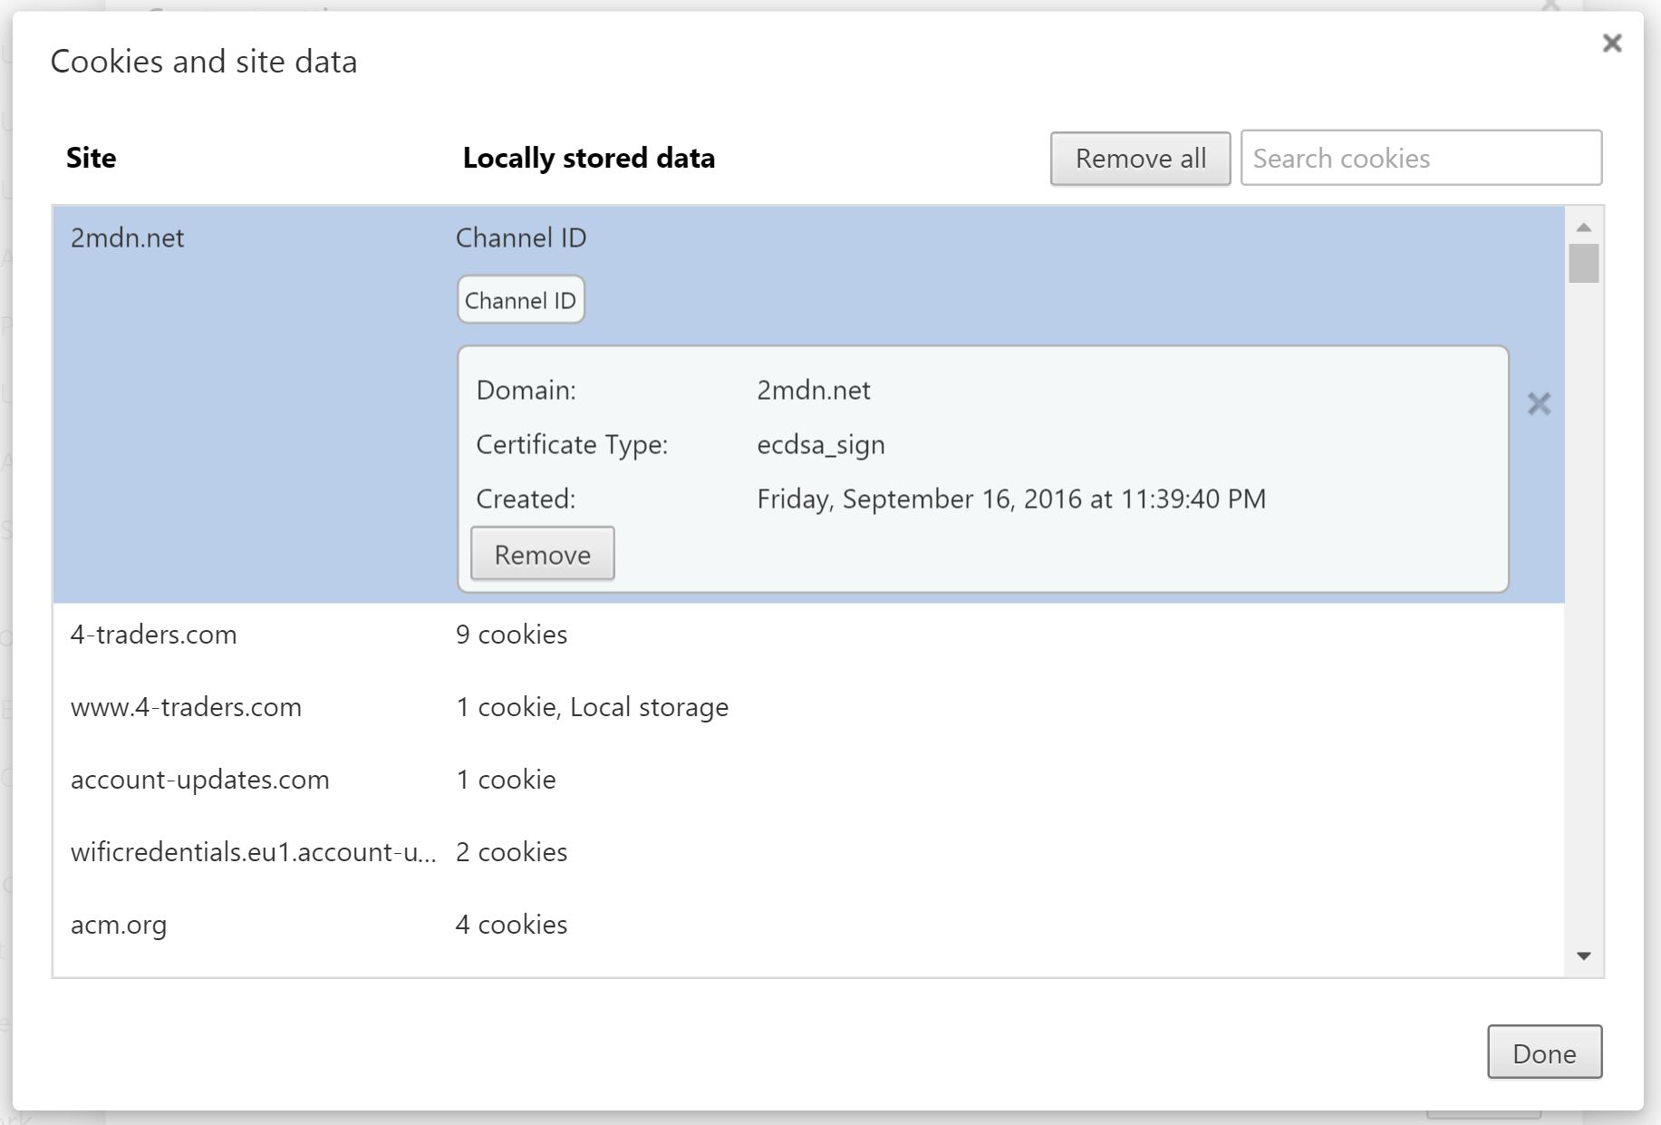

Slide 37
Cascading Style Sheets
CSS and JavaScript introduced around same time
Cascading Style Sheets
How to make styling separate from content?
HTML was difficult to change if in multiple places
HTML was hard to make visually consistent
HTML had no support for different display formats (audio, mobile)
Putting styling in HTML led to bloated pages

Slide 38
JavaScript
JavaScript
How to have greater compatibility?
ECMAScript (ES5 and now ES6)
European Computer Manufacturer’s Association
Was supposed to be a temporary name (!)
Note: JavaScript has nothing to do with Java programming language
Mostly marketing since Java was gaining popularity
JavaScript also part of the browser wars in late 1990s, with Microsoft having its own variation

Slide 39
Web Architecture Diagram
URL
Web
Browser
Internet
Server
PHP
MySQL
CSS support
HTML
Apache
JS support
CSS
Linux
JS
Cookies
Database

Slide 40
Don’t Want to Modify Web Page Files Directly
Most web servers retrieve and serve up files
But error-prone for an individual to update a page by finding file and editing it
This is where Content Management Systems (CMS) come in
Software on servers to facilitate updates
Reduces errors, improves productivity, abstractions
Ex. Drupal, Jakarta, Joomla, Wordpress
Any experiences with these?

Slide 41
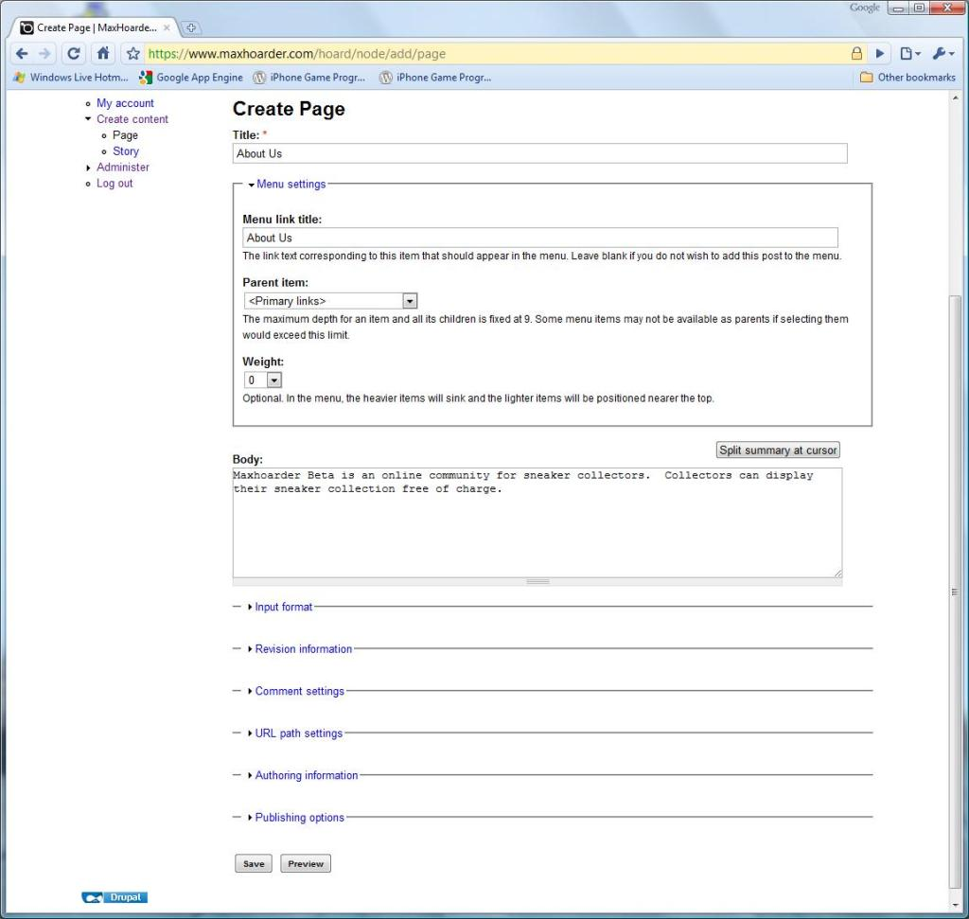
Notes:
http://makingof.maxhoarder.com/wp-content/uploads/2010/01/CreatePage_1024.jpg
Example Drupal page

Slide 42
But Performance…
For high-end web sites with lots of visitors, quickly hit bottlenecks with performance
All traffic is going through the same channels
Content Distribution Networks (CDNs)
Global networks that puts content geographically closer to users, so faster to download
Ex. Akamai, Cloudflare, Amazon CloudFront, LimeLight

Slide 43
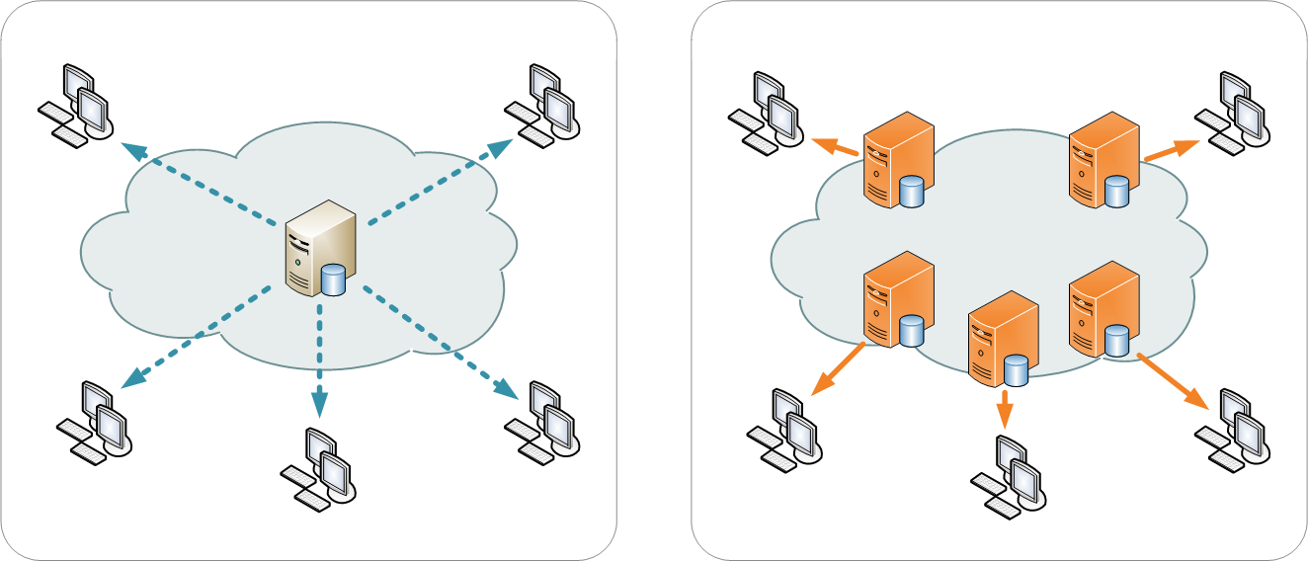
Content Distribution Networks

Slide 44
Web Architecture Diagram
CMS front-end
CDN Server
URL
Web
Browser
Internet
Server
PHP
MySQL
CSS support
HTML
CDN Server
Apache
JS support
CSS
Linux
JS
Cookies
Database

Slide 45
Administrivia
HW5 due Sunday Oct 7 at 11:59pm
Next week, I’m out of town
One lecture on accessibility, other TBD
Next next week, doing Properties of People
Read Design of Everyday Things before then
HCII upcoming talks
https://hcii.cmu.edu/news/seminars
Sep28, Christopher Myers on Synthetic Teammates

Slide 46
Web Good for Media, but…
But are there other ways of offering services?
HTML is for presentation of content, but doesn’t offer a lot of structure or semantics
<i>5000 Forbes Ave</i>
<b>76.8 °F</b>
<div>April 15, 2018 3:00pm NSH 3001</div>
In early days, people would do “screen scraping” of web content

Slide 47
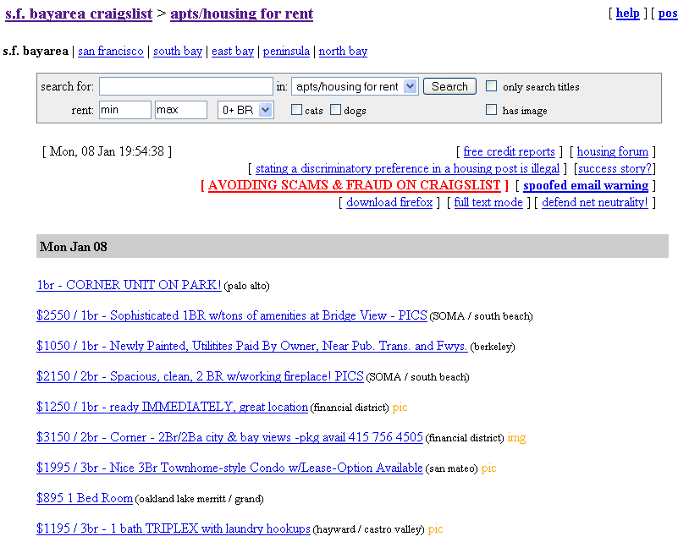

Slide 48
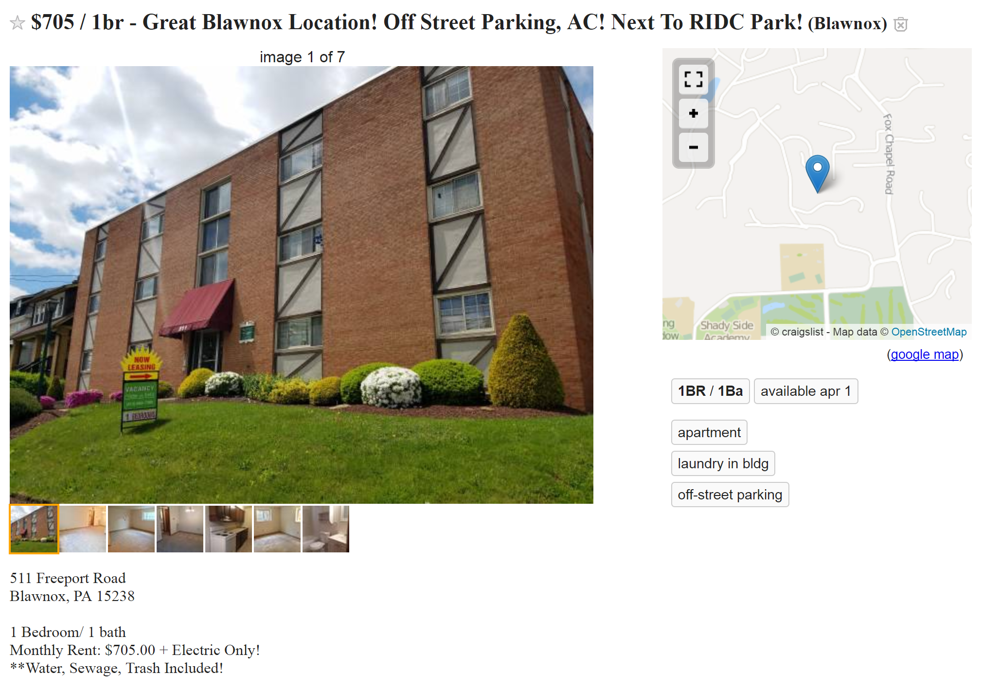

Slide 49
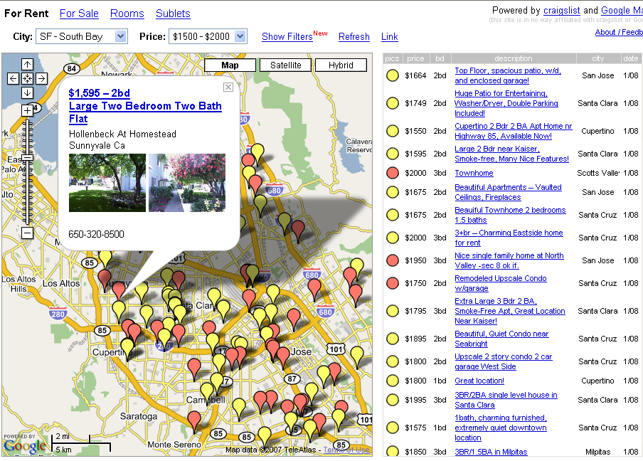

Slide 50
Web Good for Media, but…
Screen scraping was effective but brittle
Had to guess where the desired content was
Software broke if the web site changed their HTML
Can we make the web more programmable?
Make it so web sites can also offer more structured APIs, to let devs make data requests in programs
(Note: screen scraping still used if the web site does not offer an explicit API)

Slide 51
RESTful Web Services / APIs
For book, can discuss alternative approaches of CORBA and SOAP and DCOM
REST easier to understand, faster to develop for (no extra dev tools needed), faster to deploy and get results (can use browser to help test and debug), easier to debug (can see the JSON or XML object)
REST makes the common case really easy
Complexity vs easy setup via web server
Lots of overhead vs light for objects
Ease of understanding (trivial for REST)
REST got you probably 85% of the way
Extra complexity not worth it
http://stackoverflow.com/questions/19884295/soap-vs-rest-differences
REpresentational State Transfer (REST)
Dissertation by Roy Fielding, an architect of HTTP 1.1
Explains a lot of design rationale behind HTTP
Sort of a post-hoc analysis of why HTTP works well
Describes architectural style of the web
Architectural styles describe systems at high-level
Data flow (Unix pipes workflow)
Call-and-return (most programming languages)
Event-based

Slide 52
Design Rationale of Web
Anarchic Scalability
No single point of control, no single point of failure
AOL, Compuserve had custom content at the time
Had to get permission, pay them money to deploy
Independent deployment
Can add new document, server, don’t have to notify
Note that we’re going through this again today
Closed web vs open web (Google, Facebook, apps)
Note that this is related to but not same as net neutrality

Slide 53
REST-based Approach
Rely exclusively on pre-defined methods (verbs)
HTTP has GET, POST, PUT, DELETE
Define URLs (nouns)
http://weather.com/usa/pennsylvania/pittsburgh
http://weather.com/usa/georgia/atlanta
(Note: these URLs don’t work anymore)
Return content in some useful form
HTML web page or XML-formatted
To get the latest weather, just access the URL
Again, this is how web generally works

Slide 54
RESTful Web Services / APIs
REST-based APIs take this same idea
Your URLs are your APIs for accessing data
These URLs are also called endpoints
Example:
https://developers.google.com/maps/documentation/directions/
https://developer.twitter.com/en/docs/api-reference-index.html
Note: these APIs often require a developer key
Used for accountability, rate limiting, charging
Notes:
Google Places API Javascript Library
https://developers.google.com/maps/documentation/maps-static/intro

Slide 55
More REST Examples
https://www.metaweather.com/api/
Info about weather
http://www.tvmaze.com/api
Info about TV shows
See more APIs here
https://github.com/toddmotto/public-apis/blob/master/README.md

Slide 56
Some Comments about REST
Note that REST is more of a philosophy for how web services should be built, not a standard
Some example inconsistencies:
How to handle errors? 404? Or return an error object?
Should one only use GET and POST? Other verbs?
PUT, DELETE, PATCH
Should it be part of the URL or a query?
Ex. http://w.com/api/location/search/?query=atlanta
Ex. http://w.com/usa/georgia/atlanta
Notes:
Note: lots of inconsistency with REST based APIs. REST is more a general philosophy, but that doesn’t always translate well into code.
Ex. How to handle errors? Can do 404 not found (not useful), or return an error in the return object, but it varies from API to API
Ex. Should one only use GET and POST? Or should one actually use the other verbs (that no one in the world really uses)?
Ex. Differences in how REST endpoints are specified, inconsistent across APIs
Pittsburgh (doesn’t seem to work…)
https://www.metaweather.com/api/location/search/?lattlong=40.436,-79.918

Slide 57
XML and JSON
Two common ways of representing data on web
Both are functionally equivalent
It’s mostly a matter of personal preference
XML stands for Extensible Markup Language
Like HTML, but does not have predefined tags
Also stricter than HTML, formatting has to be 100% correct

Slide 58
XML Example
Basic idea: Like HTML, but more structured and with definable tags
<?xml version="1.0" encoding="UTF-8" ?>
<person>
<name type="full">John Doe</name>
<tel type="home">412-555-4444</tel>
<tel type="work">412-268-5555</tel>
<email>johndoe@anon.net</email>
</person>

Slide 59
XML Structure
XML documents have no semantics
Up to the programs using them
Often defined by a committee
XHTML is XML-formatted HTML
Currently recommended but not widely adopted yet

Slide 60
JSON
JavaScript Object Notation
Simpler to read than XML
Easier to parse in JavaScript (because it’s already JavaScript), can just read it in in a JavaScript program

Slide 61
JSON Example
{
"firstName": "John", "lastName": "Smith", "age": 25, "address": { "streetAddress": "21 2nd Street", "city": "New York", "state": "NY“ }, "spouse": null }

Slide 62
XML and JSON
Both are functionally equivalent
Generally, developers seem to prefer JSON
Easier to read, more compact
Possible browser support for viewing (debugging)
Chrome supports XML but not JSON
http://www.w3schools.com/xml/simple.xml
JSON tools
http://jsonviewer.stack.hu/
https://jsonformatter.curiousconcept.com/
Your experiences with XML and JSON?

Slide 63
How to Have Higher Interactivity?
How to have higher interactivity?
AJAX
Asynchronous JavaScript And XML
Get content from remote web server (JSON or XML)
Insert / update the DOM based on this content
Example
https://www.w3schools.com/jquery/ajax_ajax.asp
Relatively easy to do, especially with Jquery
A lot more of this in labs

Slide 64
Web Architecture Diagram
CMS front-end
CDN Servers
URL
Web
Browser
Internet
Server
PHP
MySQL
CSS support
HTML
REST
APIs
Apache
JS support
CSS
Linux
JS
Cookies
Database

Slide 65
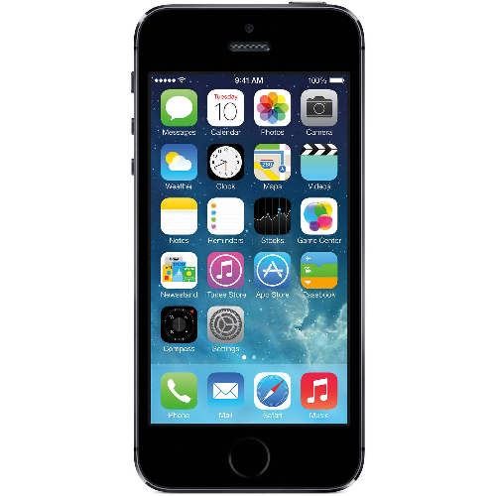





Cloud Services
REST
APIs
CMS front-end
Cloud computing
Mobile web
Apps
Tracking and privacy
URL
CDN Server
Internet
Web
Browser
Server
PHP
CSS support
MySQL
HTML
JS support
CSS
REST
APIs
Apache
JS
Plugins
Linux
Cookies
HTML5 / Canvas
Tracking, APIs
Database
WebASM

Slide 66
Stepping Back
Web started as a document-oriented medium
Lots of other features shoehorned in afterward
CSS + JavaScript
Security
Streaming video
HTML5 Canvas
Lacks many desired properties of good software
Modularity / encapsulation
HTML/CSS/JavaScript + SQL + Perl/Python/Java

Slide 67
Stepping Back
This is mostly how the web works today
…But this is not necessarily how it will work tomorrow
A lot of it evolved based on WIMP
Windows, Icons, Menus, Pointer
But new interaction modes are coming
Speech, gesture, AI systems
And lots of paths we haven’t explored
Ex. Lots of other forms of hypertext

Slide 68
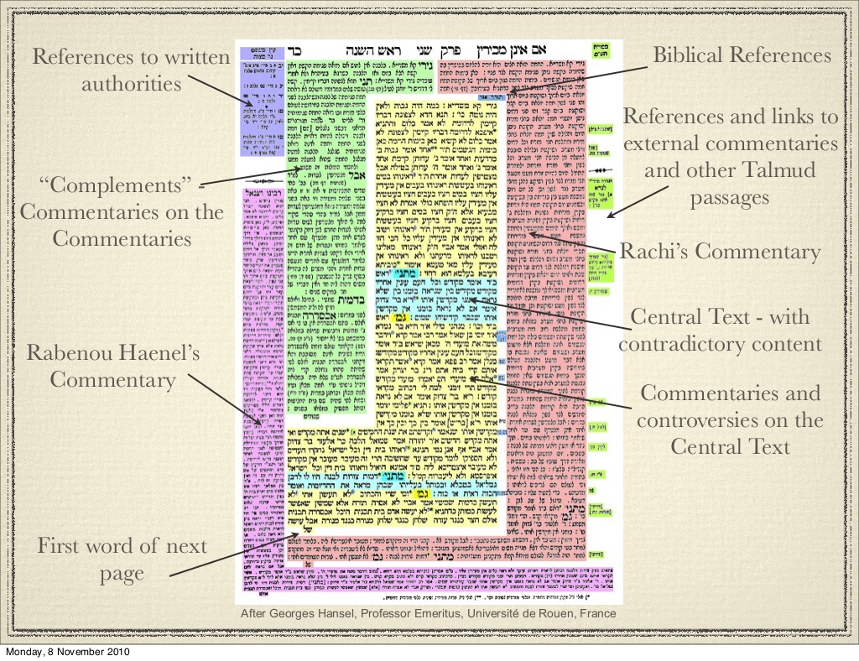
Notes:
http://blog.tech7.community/beer-sheva-a-case-study-from-a-jewish-perspective/

Slide 69
Administrivia
HW5 due Sunday Oct 7 at 11:59pm
Next week, I’m out of town
One lecture on accessibility, other TBD
Next next week, doing Properties of People
Read Design of Everyday Things before then
HCII upcoming talks
https://hcii.cmu.edu/news/seminars
Sep28, Christopher Myers on Synthetic Teammates

Slide 71
This is Why Web Programming is so Complex and Hard to Do
At a minimum, today's rich applications must generate HTML, for document structure; CSS, for document formatting; JavaScript, a scripting language for client-side interactivity; and messages of HTTP, a protocol for sending all of the above and more, to and from browsers.
Ur/Web: A Simple Model for Programming the Web https://cacm.acm.org/magazines/2016/8/205041-ur-web/abstract
Notes:
From Ur/Web: A Simple Model for Programming the Web
https://cacm.acm.org/magazines/2016/8/205041-ur-web/abstract

Slide 72
This is Why Web Programming is so Complex and Hard to Do
Most recent, popular applications also rely on languages like JSON for serializing complex datatypes for network communication, and on languages or APIs like SQL for storing persistent, structured data on servers. Code fragments in these different languages are often embedded within each other in complex ways, and the popular Web development tools provide little help in catching inconsistencies.
Notes:
From Ur/Web: A Simple Model for Programming the Web
https://cacm.acm.org/magazines/2016/8/205041-ur-web/abstract

Slide 73
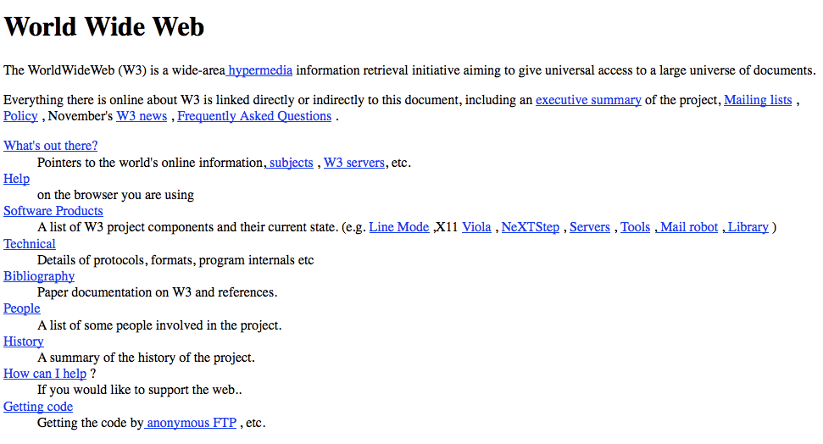
In the beginning
HTML, URL, HTTP
Browser - Server
Notes:
Screenshot of first web page by Tim Berners Lee

